Slide 1
MESH MESSAGING SERVICE USING BLUETOOTH
Presented by
P. Hitesh Reddy, P. Ruchitha, , P. Ashish ,R.B.Moulya ,S.Amisha
Computer Science and Engineering
Sree Vidyanikethan Engineering College
Tirupati, India
19121A05N2@vidyanikethan.asia
Dr. Aswini.J
Computer Science and Engineering
Sree Vidyanikethan Engineering College
Tirupati, India
aswini.j@vidyanikethan.edu

Slide 2
Contents
Abstract
Introduction
Statement of the problem
Objectives
Existing system
Proposed system
Conclusion
Future Scope
References

Slide 3
Abstract
The idea is to create a service that enables users to communicate with other users using a Mesh Network established between their devices. The Mesh network is to be built using the Bluetooth service available in the user devices. There are apps built using this technology such as Bridgefy, Mesh Messaging, Firechat, etc. But the proposed application enables users to send messages to other users through the Bluetooth network established between the user devices. The application does not require any Internet connection. The idea is to transfer data from the sender to the receiver where it finds its way using a Dynamic routing algorithm. The middle devices (user devices that are not participating in the communication) act as routers in the network. The app encrypts the messages which are sent from the sender so that the middle devices cannot see them.

Slide 4
Introduction
Bluetooth is an open standard for implementing short-range wireless communication.
The data is transferred through the network with the help of the mesh networking technology. The working principle is that the devices which take part in the network act as the endpoint devices as well as the routers of the network. The more the number of devices, the better the functionality of the network.
It is deployed with a situation based Routing algorithm, which will be customized to work with the Bluetooth technology.
To protect the messages from third persons it will be deployed with a strong and efficient Encryption algorithm.
The App will be built in VS code usin cog Flutter for Android devices.
With the proposed application the users can message even without internet connection or 2G, 3G, or 4G networkverage using Bluetooth.

Slide 5
Statement of Problem
One of the most available modes of communication is messaging over either the internet or mobile network. Over 6 billion texts are sent every day. Platforms like WhatsApp, Twitter, Instagram have become the primary source of information through communication. Those are enabled through either an Internet connection or through a Mobile Network.
The proposed idea aims to provide an alternate way for communication using Bluetooth. It is to build an app that lets the user send messages without any of the regular connectivity. The users can connect to each other directly and pass messages over the network they create. The messages sent over this network hop across it until it reaches its destination. This service is also entirely free of cost. The effectiveness of this idea increases as the number of active users increases.

Slide 6
Objectives
Designing a clean and simple user interface, so the users can use the application with ease.
Adding mobile number authentication during the initial run of the application, to verify the legitimacy of the users.
Creating a database to store the data locally on the user device, so that it can be available when offline.
Implementing an asymmetric encryption service to ensure that the privacy of the users is respected.
Adding a functionality which enables the users to start a new conversation by scanning a QR code on the other user’s application.
Designing a dynamic routing algorithm that can respond to the constant changes in the topology of the network.
To prevent clogging up of the network by duplicate packets, adding a time to live for the network packets.

Slide 7
Existing system
Applications like Bridgefy and Firechat already explore this idea to an extent. Their purpose involves creating a communication stream between users by utilizing the Bluetooth service. They have been popular on various occasions, one of which is the Hong Kong protests, where the protesters used these applications to establish a communication channel only for themselves and stay under the government’s radar.
A project has already been done, which has the same premise as ours. The contributors to that project has successfully built an application that can build a mesh network between the user devices using Bluetooth and pass messages over it. This application was named ‘Beacon’.

Slide 8
Proposed system
The proposed system aims to establish a functioning mesh network between the user devices to transfer messages among them. The network is dynamic and adaptive of the constant changes in the topology of the network. The security for the privacy of the users can be taken care by the encryption that has been implemented in the system. This service utilizes the RSA asymmetric algorithm to encrypt and decrypt messages to ensure that only the intended parties can read them.
The application works without any internet connection. Due to this, it must store the data locally on the user device. This data includes the messages sent and received, the contacts, personal details. This is implemented by creating a local SQLite database on the user device. Material design is used to provide an appealing UI to the users.

Slide 9
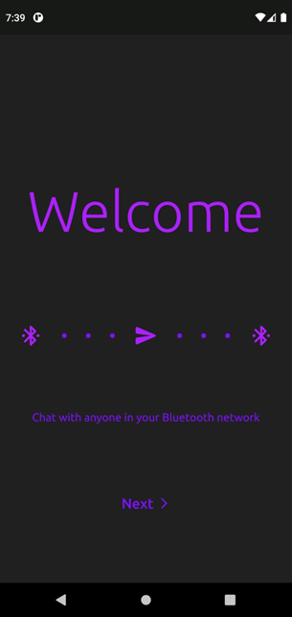
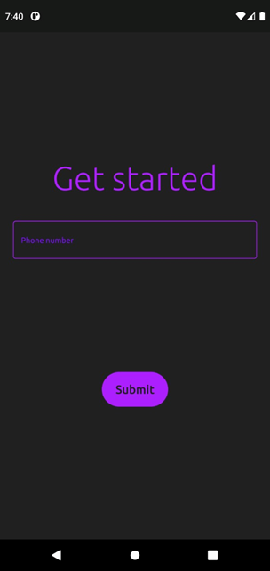
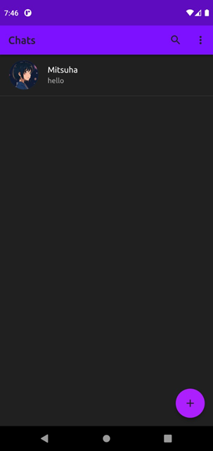
Application Screenshots

Slide 10
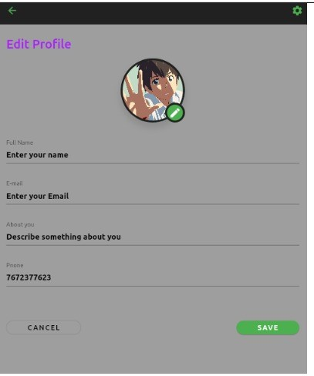
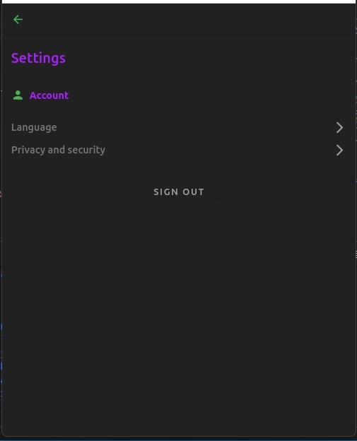
Application Screenshots

Slide 11
Result and Analysis
The application was tested against the requirements document that has been prepared during the inception of this idea. Aspects like the speed, understandability, ease of usage of the application were tested. Along with these, the total time of transmission of a message was calculated at varying distances and varying number of nodes between the sender and receiver.
The results yielded were estimated to satisfy a generic user.

Slide 12
Future Scope
The application can be embedded as a feature into the already existing messaging platforms like WhatsApp messenger, Facebook Messenger, Instagram messenger etc.
There would be a situation that always exists when the users are disconnected from the communication network either because of lack of connectivity or a server-side issue of the application. This causes disruption in their communication. But when use this as a feature with regular messaging platforms, Then the issue can be solved as we can send messages using this when we don’t have internet connectivity or carriage and as it passes person by person if it finds internet it reaches the destination using internet.
This is idea is being researched upon to know if the toggling between the networks based on the situations is practical or not.

Slide 13
Conclusion
This application was built based on the Feedback of different people in the society on the problem they are facing while sending messages. This application extends providing communication at the time of natural calamities, providing communication in remote places, and providing communication in the closed places. So, the complete ideology was built to solve this problem. This application has been built using flutter framework and Dart Programming Language in the view of extending it to the iOS in future. This application would make the people overcome the problem they are facing while transmitting messages.

Slide 14
References
Gomez, Carles & Oller Bosch, Joaquim & Paradells, Josep. (2012). Overview and Evaluation of Bluetooth Low Energy: An Emerging Low-Power Wireless Technology. Sensors (Basel, Switzerland). 12. 11734-53. 10.3390/s120911734.
Lee Barken, Eric Bermel, John Eder, Matthew Fanady, Michael Mee, Marc Palumbo, Alan Koebrick, Wireless Hacking, Syngress, 2004, Pages 215-224, ISBN 9781931836371
Xin Zhou and Xiaofei Tang, "Research and implementation of RSA algorithm for encryption and decryption," Proceedings of 2011 6th International Forum on Strategic Technology, 2011, pp. 1118-1121, doi: 10.1109/IFOST.2011.6021216
Misra, S. and Goswami, S. (2017). Fundamental Routing Protocols. In Network Routing (eds S. Misra and S. Goswami). https://doi.org/10.1002/9781119114864.ch3

Slide 15
Contd.
W. Pan, F. Luo and L. Xu, "Research and design of chatting room system based on Android Bluetooth" 2012 2nd International Conference on Consumer Electronics, Communications and Networks (CECNet), 2012, pp. 3390- 3393, doi: 10.1109/CECNet.2012.6201484.
Ghori, Muhammad & Wan, Tat-Chee & Sodhy, Gian. (2020). Bluetooth Low Energy Mesh Networks: Survey of Communication and Security Protocols. Sensors. 20. 3590. 10.3390/s20123590.
Ng, P.C.; She, J. A Novel Overlay Mesh with Bluetooth Low Energy Network. In Proceedings of the IEEE Wireless Communications and Networking Conference (WCNC), Marrakesh, Morocco, 15–18 April 2019; pp. 1–6.
Chiumento, A.; Reynders, B.; Murillo, Y.; Pollin, S. Building a connected BLE mesh: A network inference study. In Proceedings of the IEEE Wireless Communications and Networking Conference Workshops(WCNCW), Barcelona, Spain, 15–18 April 2018.

Slide 16
Contd.
Patti, G.; Leonardi, L.; Lo Bello, L. A Bluetooth Low Energy real-time protocol for Industrial Wireless mesh Networks. In Proceedings of the IECON 2016-42nd Annual Conference of the IEEE Industrial Electronics Society, Florence, Italy, 23–26 October 2016; pp. 4627–4632.
Vijay, R.; Prabhakar, T.V.; Hegde, V.; Rao, V.S.; Prasad, R.V. A Heterogeneous PLC with BLE Mesh network for Reliable and Real-time Smart Cargo Monitoring. In Proceedings of the IEEE International Symposium on Power Line Communications and its Applications (ISPLC), Praha, Czech Republic, 3–5 April 2019; pp. 1–6.
domnicai, A.; Fournier, J.A.A.; Masson, A. Hardware Security Threats Against Bluetooth Mesh Networks. In Proceedings of the IEEE Conference on Communications and Network Security (CNS), Beijing, China 30 May–1 June 2018; pp. 1–9.
onzetta, A.M.; Cope, P.; Campbell, J.; Mohd, B.J. Security Vulnerabilities in Bluetooth Technology as Used in IoT. J. Sens. Actuator Netw. 2018,7, 28.

Slide 17
Queries

Slide 18
Thank You

